Slide 1
Test Q: What are all the factors that could influence residential home prices across the United States over the next decade? And how? Organize your output in a MECE framework. Select any format and send us a URL in 5 days.
Candidate Name : Chandra Akash Kiran
Contact no: 8602201879
Github : https://github.com/chandraAkiran/

Slide 2
Factors Affecting home prices across the United States
Demographics
Age
Gender
Interest Rates
Government Policies/ Subsidies
Income
Migration Patterns
GDP
Unempolyment Rate
Manufacturing Growth
Prices of Goods and Services
Location
Economy

Slide 3
Demographics:
Demographics play a big role in the success or failure of a real estate investment. However, demographic data and realities are not static; they are constantly changing, and can be influenced by an extreme range of factors that are not limited to one particular area.
For example, the population at particular location in the city has increased. That location is an excellent area to buy rental properties. Many of property management client will prefer to buy properties.
So demographic trend like this can increase or decrease the price of the property.

Slide 4
Economy:
The Economy Another key factor that affects the value of real estate is the overall health of the economy. This is generally measured by economic indicators such as the GDP, employment data, manufacturing activity, the prices of goods, etc. Broadly speaking, when the economy is sluggish, so is real estate.
If economy growth is increasing than the price of property also increase as well and vica versa.

Slide 5
Interest Rates:
Interest rates will increase or decrease the cost of mortgage capital, which affects you every time you decide to purchase a property. Mortgage debt is more expensive when interest rates go up. Conversely, you’ll pay less when interest rates go down.

Slide 6
Government Policies/ Subsidies:
The effect of government policy on real estate is significant as the real estate sector plays a significant role in the overall economy of a country.
Government policies not only maintain a healthy business environment but also stabilise the economy and guide decision making.
As policies reflect the interests of different stakeholders, they are designed in collaboration with industry experts. The physical, financial, personal, and land-use segment of the real estate sector is all linked to government policy.
A progressive and forward-looking policy which aligns real estate priorities with specific needs of our time can help Pakistan revive its realty sector for a sustainable future.

Slide 7
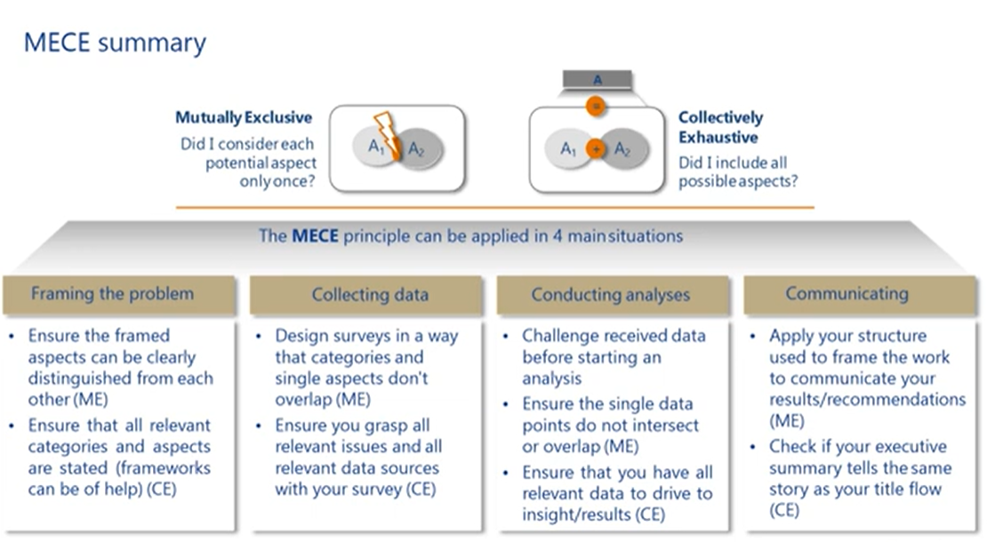

Slide 8
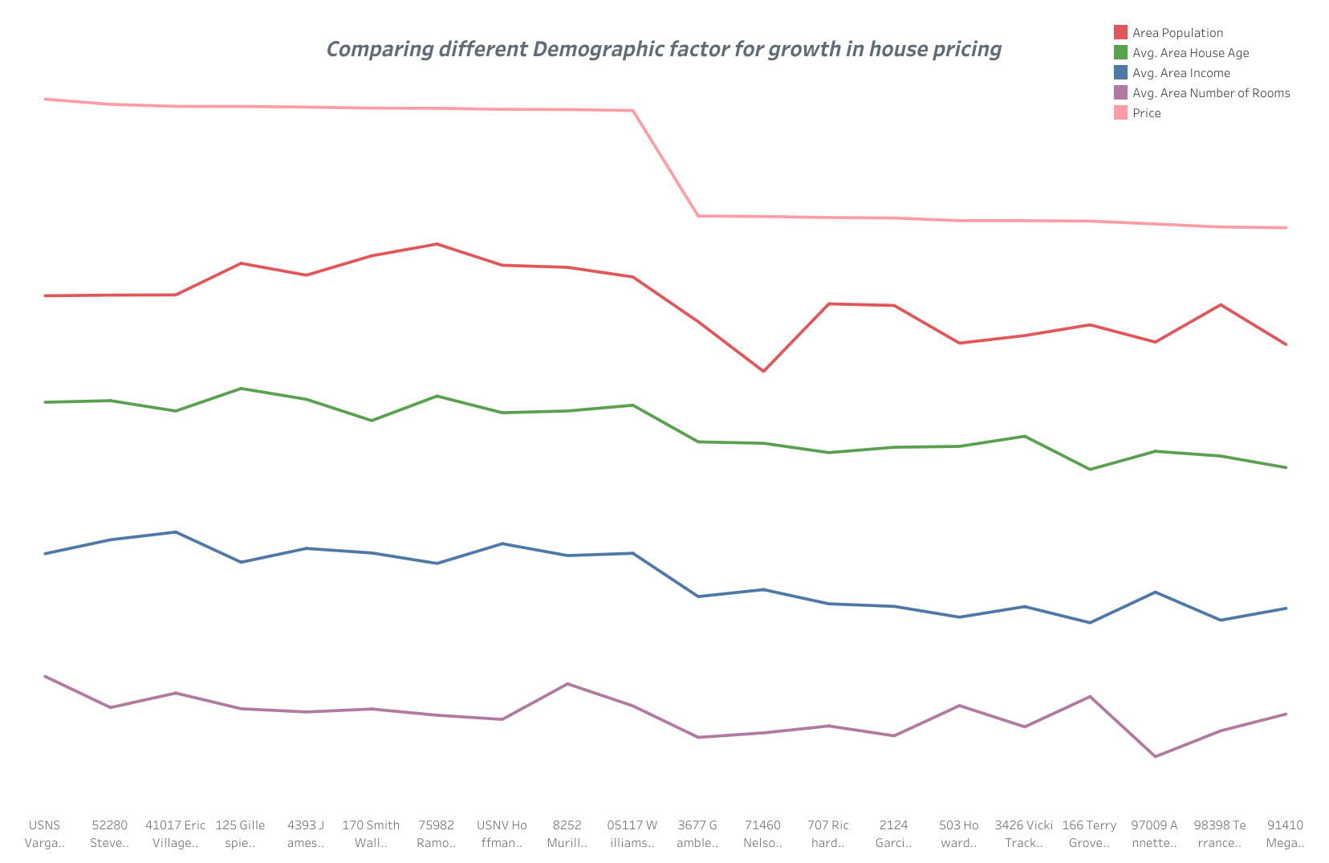

Slide 9
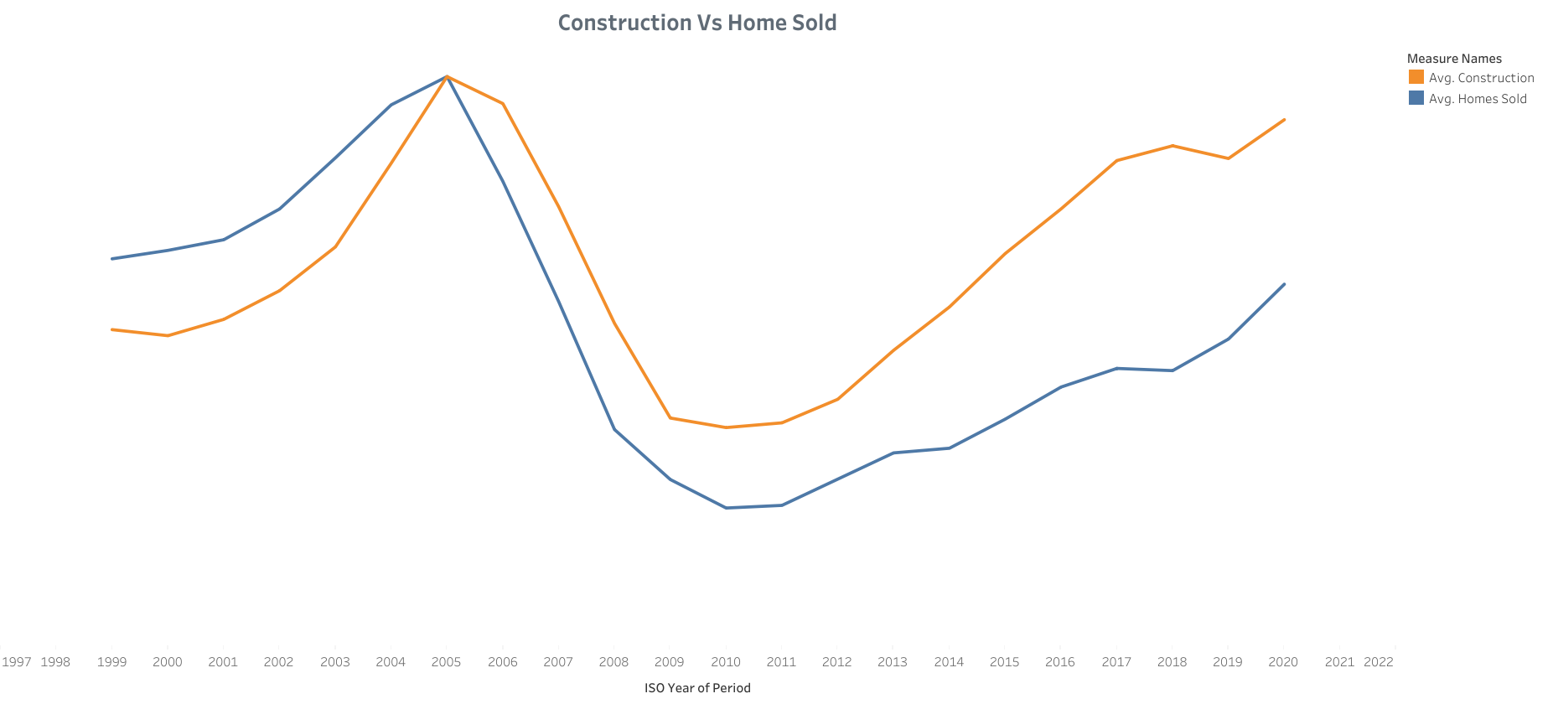

Slide 10
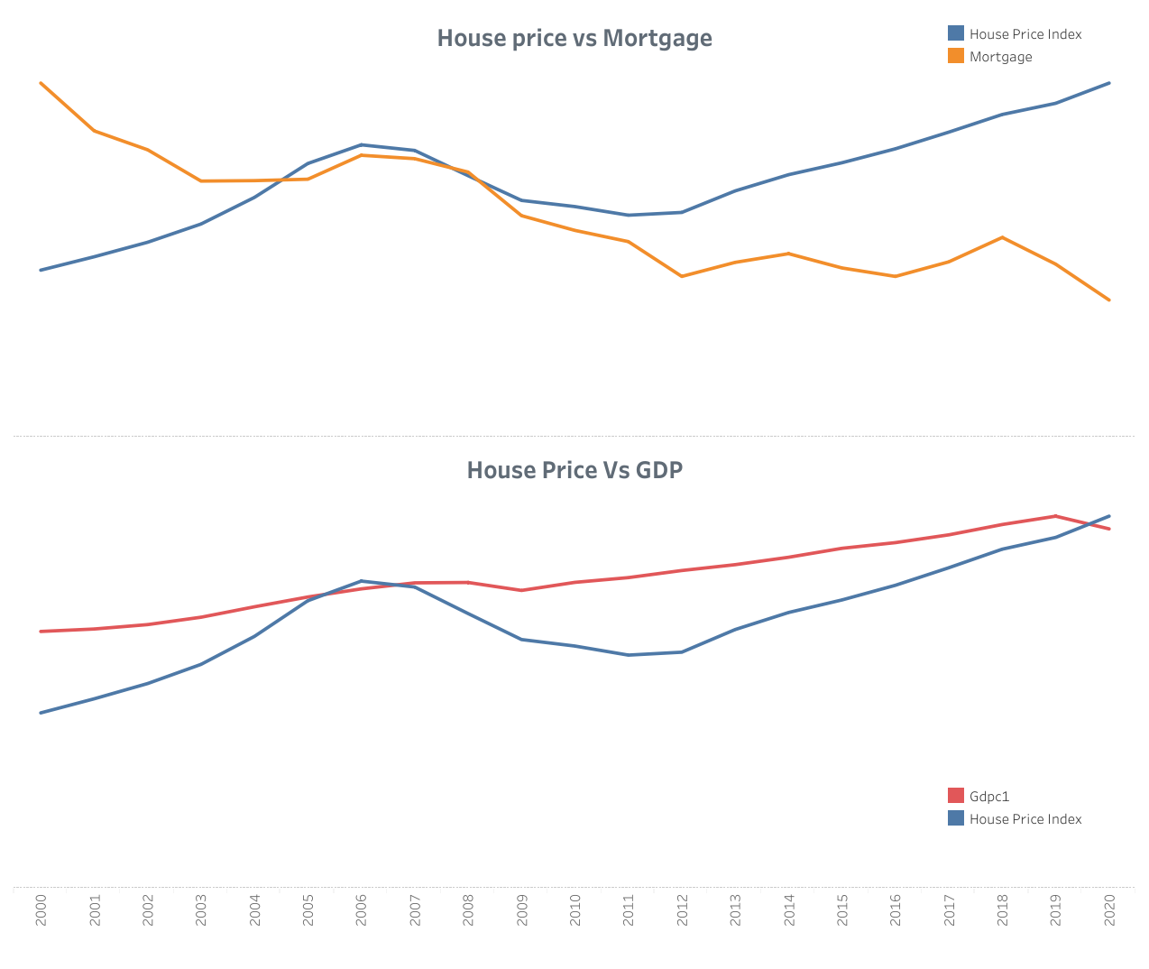

Slide 11
Conclusion:
Demographics, Economy, Interest Rate, Government Policies/ Subsidies are the factors that can influence residential home prices across the United States over the next decade.
In graphs we can clearly visualize that all 4 factors are influence home prices.
All 4 factors are not related to each other and all are necessary for home prices. So that all these factors are design according to MECE framework.

Slide 12
Thankyou

